Slide 1

User Manual
SAP - APPROVAL WORKFLOW
User Manual - SAP approval workflow

Slide 2
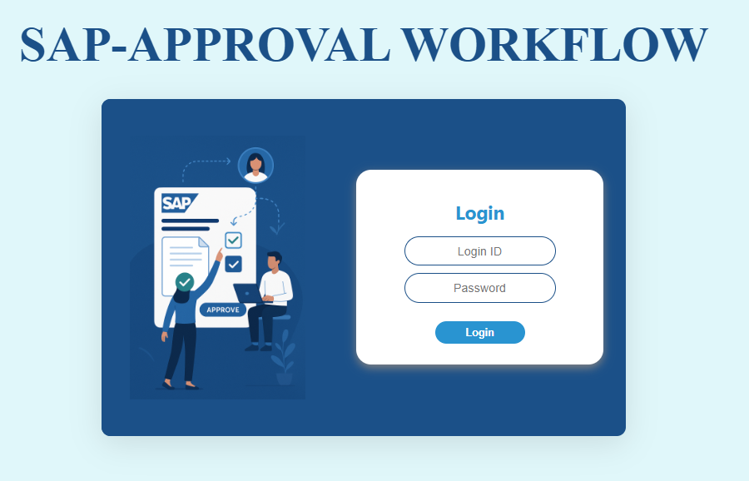
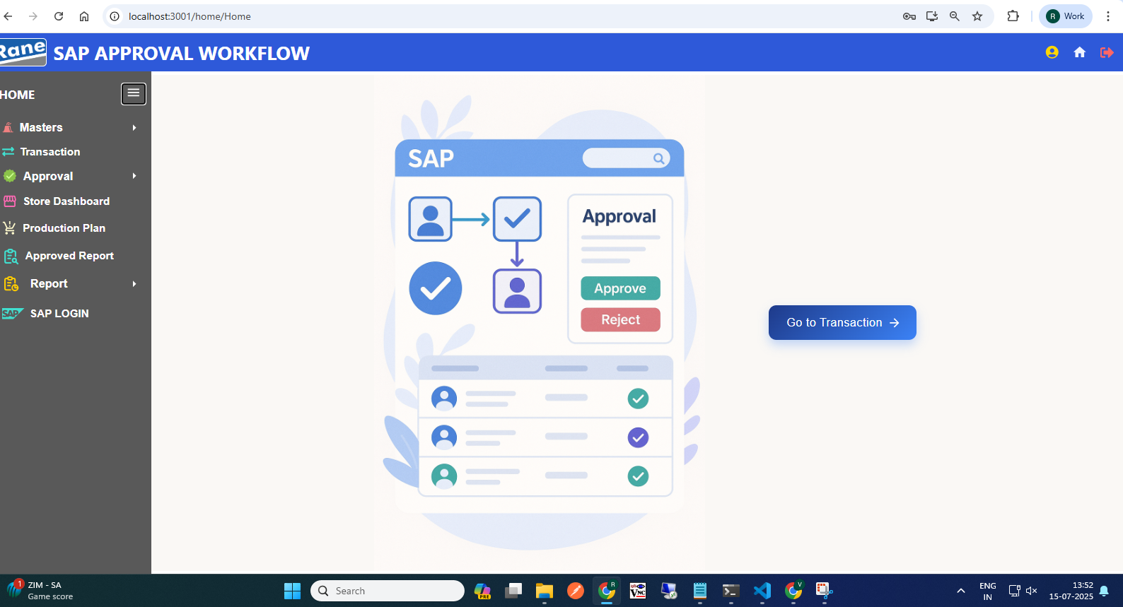
Login Page
Home Page
2
Click Here, go to the Transaction Dashboard

Slide 3
Part no conversion
( 309 Movement )
User Manual - SAP approval workflow

Slide 4
309 Movement Transaction
Process workflow:
1.Create Request by Users ( PROD / MMD / QAD / MED )
2.Upload Process - Fill in required details
3. Upload Output:
i) New Records, ii) Error Records, iii)Duplicate Records
4. Submit for Approval to Level 1 User.
Level 1 : PLANT FINANCE HEAD
Level 2 : PLANT MRPC
Level 3 : PLANT HEAD
Level 4 : CORP FINANCE HEAD
Level 5 : CORP MRPC
5. Requester Page Visible Data: - Only data uploaded by the logged-in user,
Statuses: Pending, Under Query
6. Download Option: - Filtered by From–To Date & Movement Type
7. Editability: - Enabled only if status is Under Query
8. Resubmit Workflow: - Enabled only if status is Under Query Select rows using checkboxes After making corrections, click Resubmit
5

Slide 5
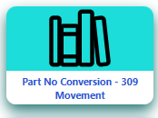
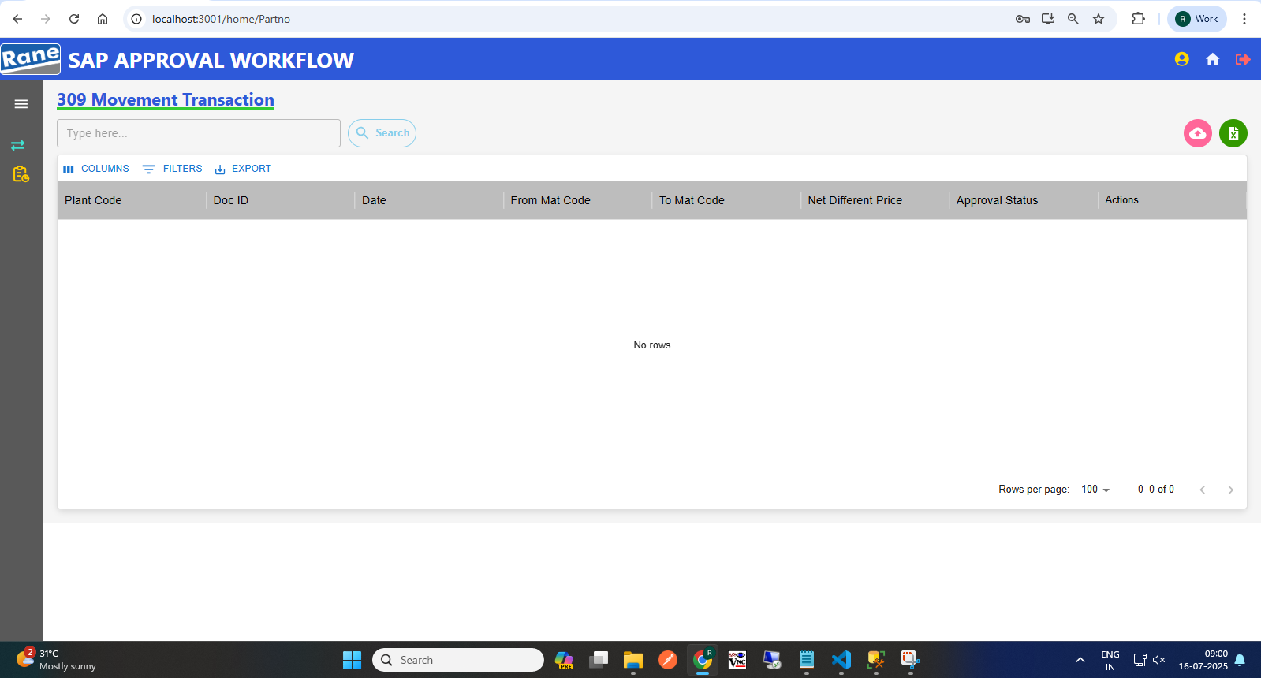
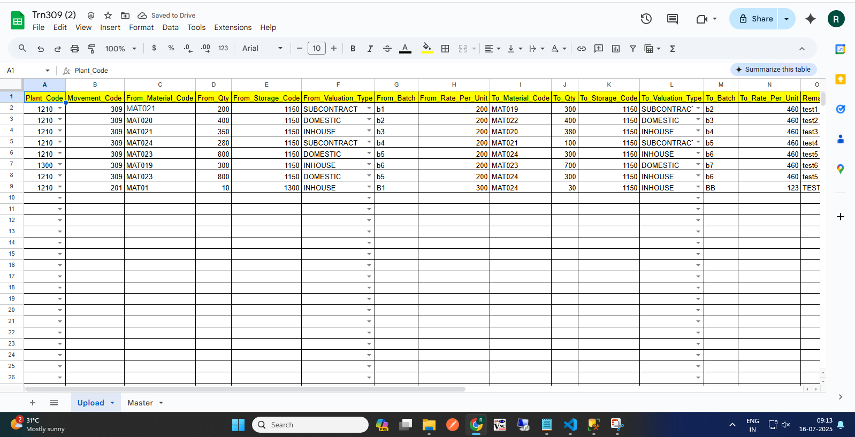
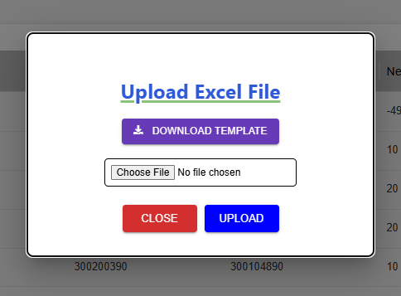
309 Movement Request (Requester)
(2) Click here to Download template
(1)Transaction Page Navigation
(2)Click to Start a 309 Request
Requester Page
Click here
(4) Excel Template with Sample Data
(3) Upload
(1) Click to begin a 309 request
(5) Approval workflow
Request >>> L1 Approver: Plant Finance Head >>> L2 Approver: Plant MRPC >>> L3 Approver: Plant Head >>> L4 Approver: CORP Finance Head >>> L5 Approver: Corp MRPC >>> Send to SAP.

Slide 6
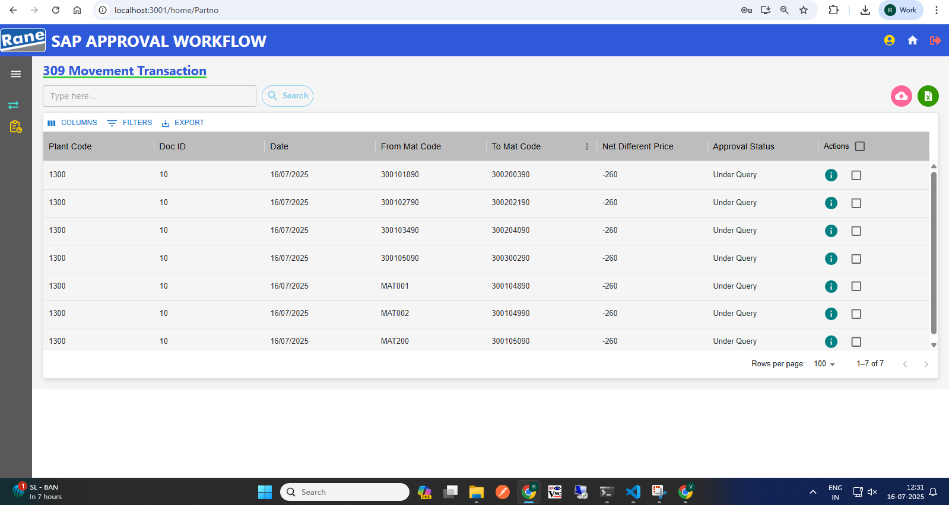
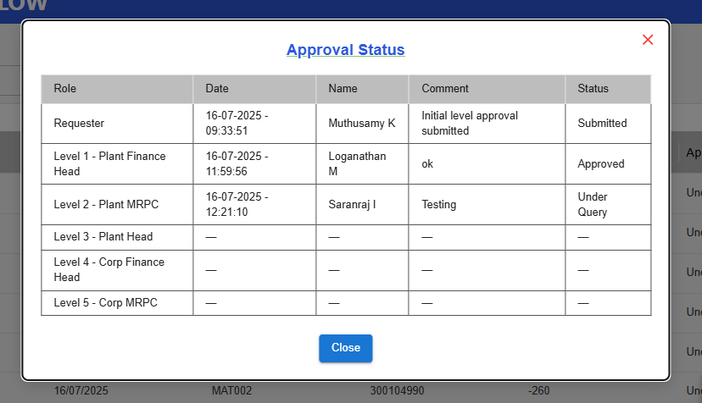
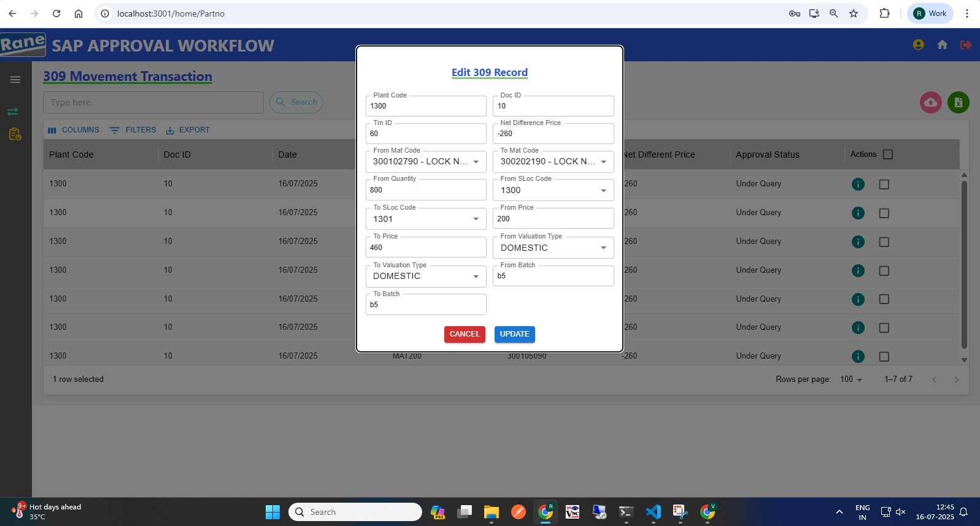
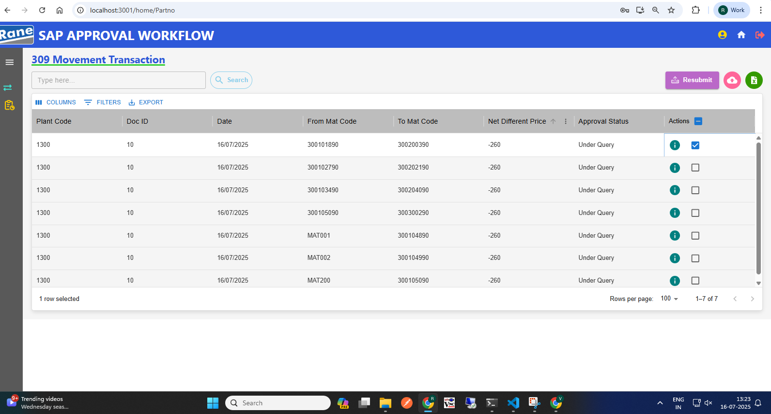
309 Movement: Edit with Status "Under Query" (Requester)
4
(2) View the Approval Level & Status
(3) Click Row to Edit Row, Then Update
(1) Requester Page After "Under Query" Status
(1) Click here to View status
(4) Select Checkbox, Then Submit Data
Resubmit workflow
Status: Under Query>>> Edit>>> Re-submit>>>Send to Approver.

Slide 7
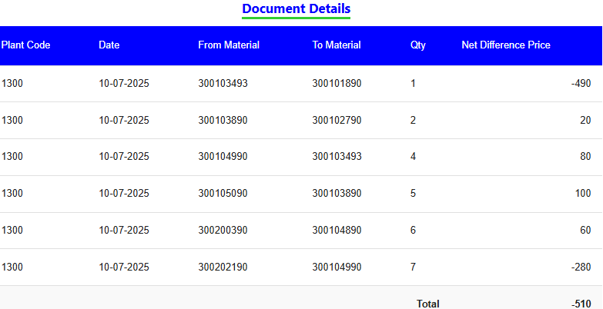
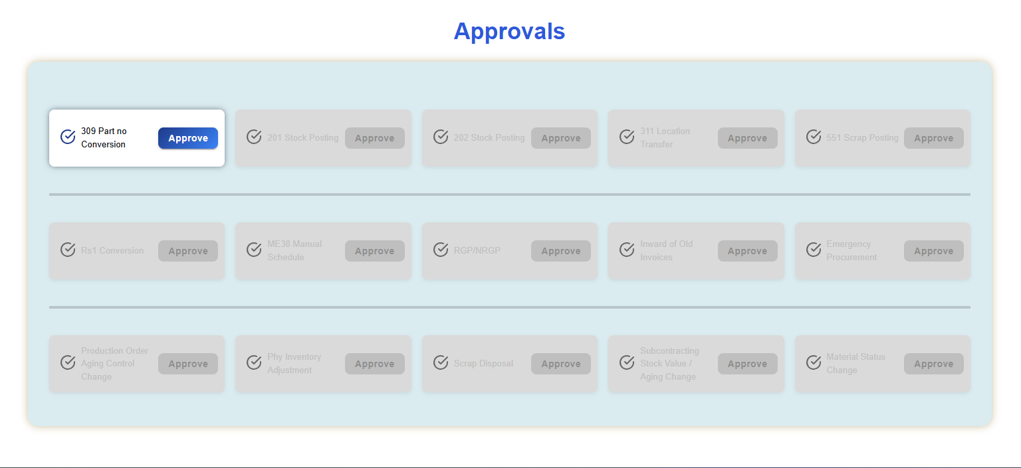
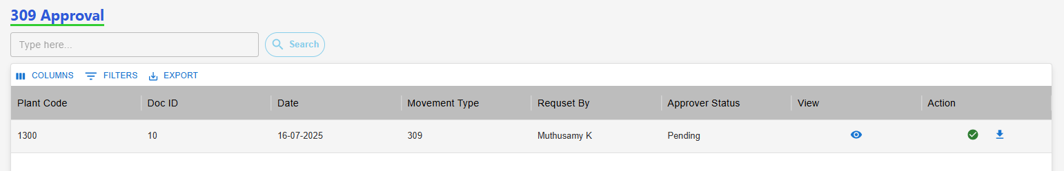
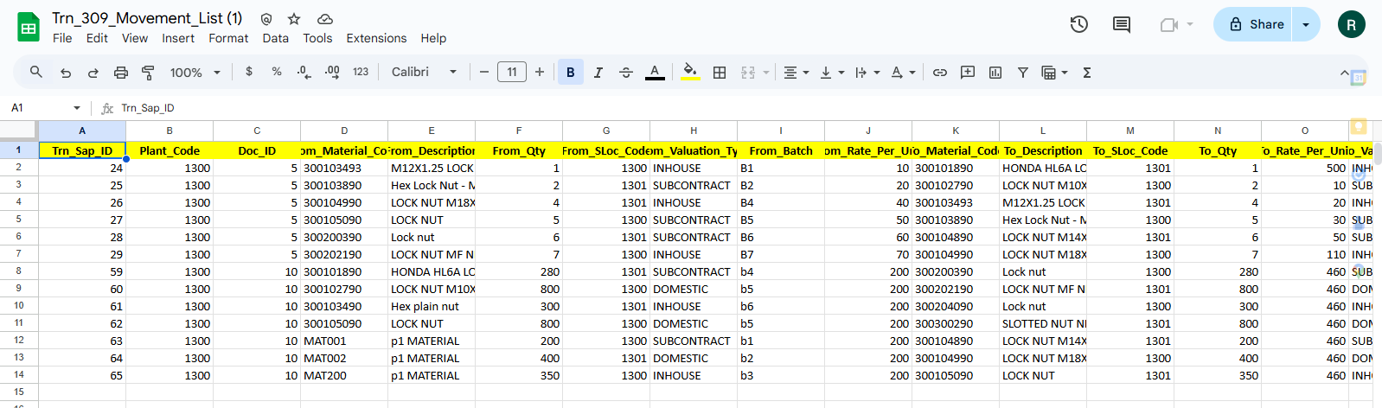
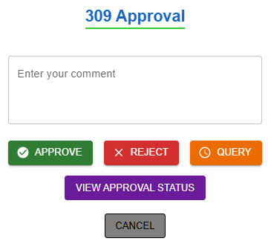
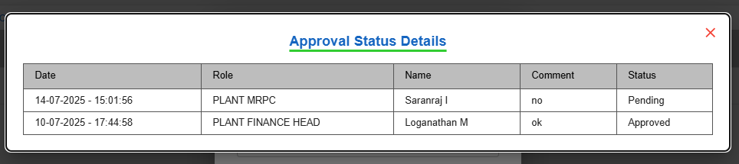
309 Movement Approval (Approver)
Pending request : View the Net Differences.
Then download the XLSX file to review the records.
After reviewing, take the appropriate Action: Approve, Reject, or Raise a Query.
(3) View Net Different
Approver Home Page
(2)View Net Difference, Download Records, Take Action
(1) Click here, 309 Approval
(6) Click Download Icon to View Records
(4)Action
(5) Click "View Approval Status" to See Last Update
Approver Make Action
Approval workflow: Request >>> L1 Approver: Plant Finance Head >>> L2 Approver: Plant MRPC >>> L3 Approver: Plant Head >>> L4 Approver: CORP Finance Head >>> L5 Approver: Corp MRPC

Slide 8
Stock Adjustment
( 201 Movement )
User Manual - SAP approval workflow

Slide 9
201 Movement Transaction
Process workflow:
1.Create Request by Users ( PROD / MMD / QAD / MED )
2.Upload Process - Fill in required details
3. Upload Output:
i) New Records, ii) Error Records, iii)Duplicate Records
4. Submit for Approval to Level 1 User.
Level 1 : PLANT FINANCE HEAD
Level 2 : PLANT MRPC
Level 3 : PLANT HEAD
Level 4 : CORP FINANCE HEAD
Level 5 : CORP MRPC
5. Requester Page Visible Data: - Only data uploaded by the logged-in user,
Statuses: Pending, Under Query
6. Download Option: - Filtered by From–To Date & Movement Type
7. Editability: - Enabled only if status is Under Query
8. Resubmit Workflow: - Enabled only if status is Under Query Select rows using checkboxes After making corrections, click Resubmit
5

Slide 10
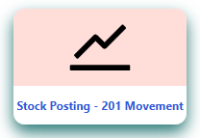
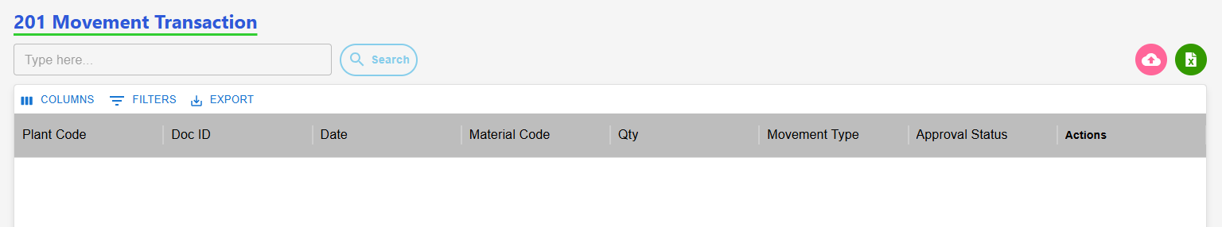
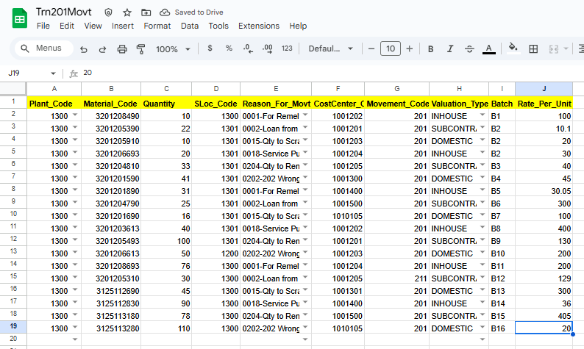
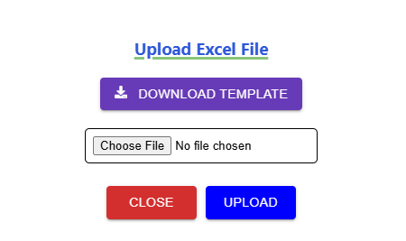
201 Movement Request (Requester)
(2)Click to Start a 201 Request
(2)Clic(2)Click to Start a 201 Request
k to Start a 201 Request
(1)Transaction Page Navigation
(2)Click to Start a 201 Request
201 Requester Page
Click here
(3) Click here to Download template
(5)Excel Template with Sample Data
(4) Click Row to Upload
(6) Approval workflow
Request >>> L1 Approver: Plant Finance Head >>> L2 Approver: Plant MRPC >>> L3 Approver: Plant Head >>> L4 Approver: CORP Finance Head >>> L5 Approver: Corp MRPC >>> Send to SAP.

Slide 11
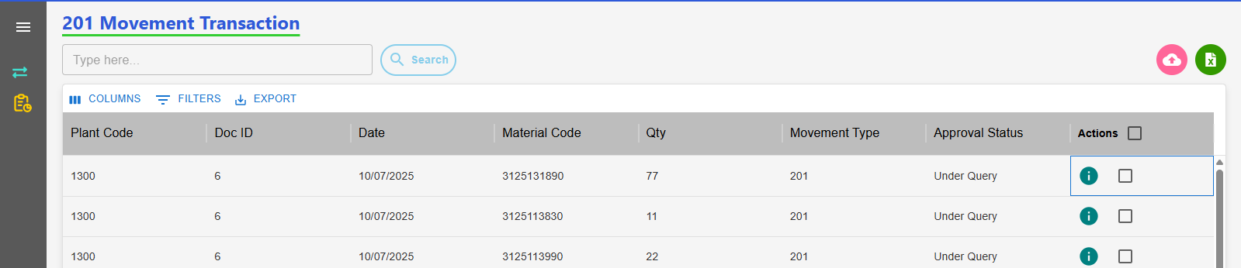
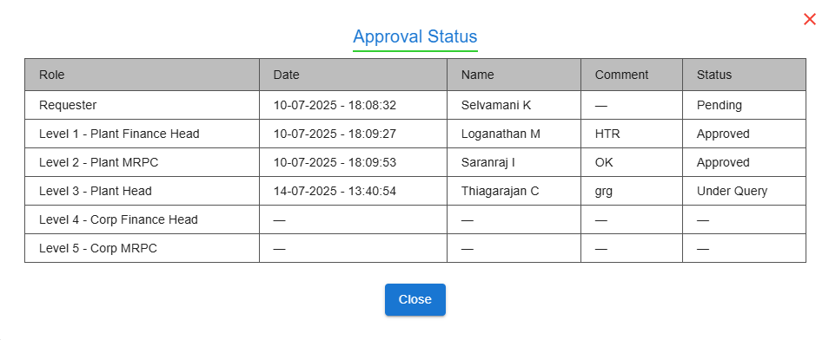
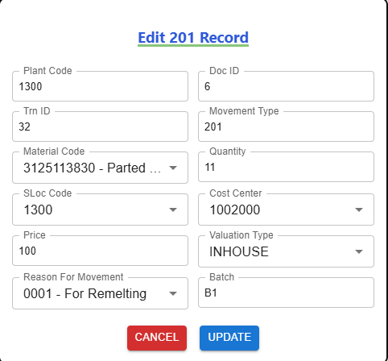
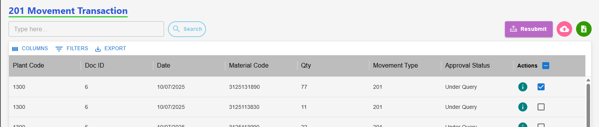
201 Movement: Edit with Status "Under Query" (Requester)
Requester Page After "Under Query" Status
(2) View the Approval Level & Status
(3) Click Row to Edit Row, Then Update
(1) Click here to View status
(4) Select Checkbox, Then Submit Data
Resubmit workflow
Status: Under Query>>> Edit>>> Re-submit>>>Send to Approver.

Slide 12
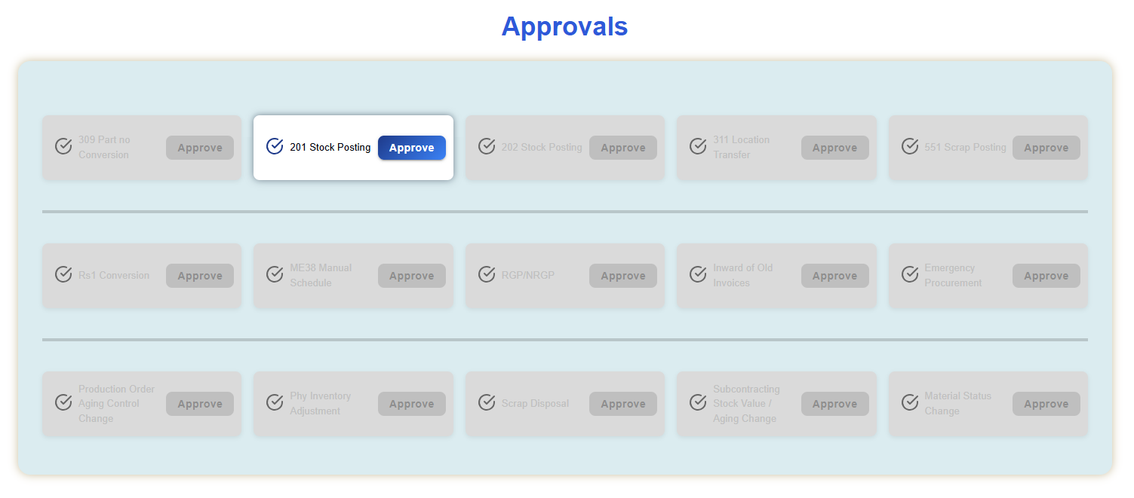
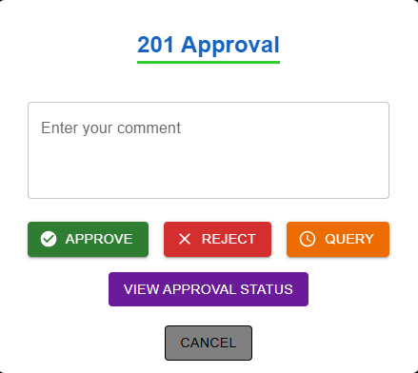
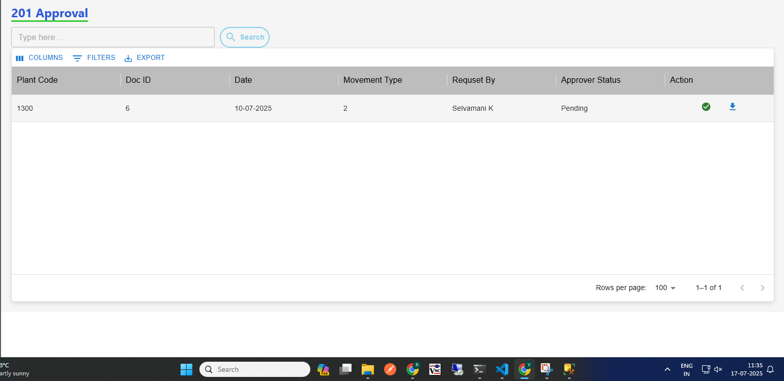
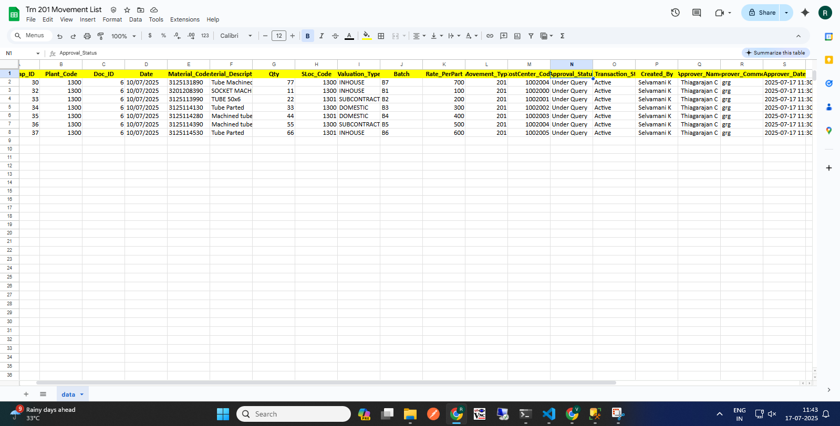
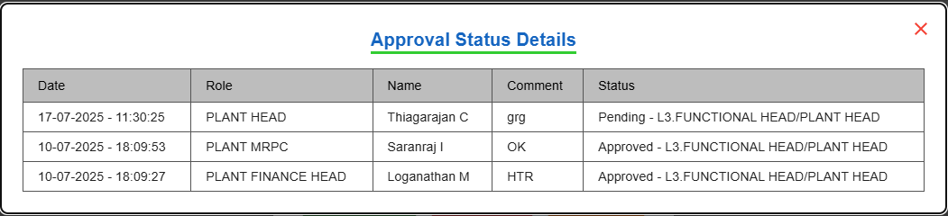
201 Movement Approval (Approver)
Pending request : View the Net Differences.
Then download the XLSX file to review the records.
After reviewing, take the appropriate Action: Approve, Reject, or Raise a Query.
View Status
(1)Approver Home Page
(2)Download Records, Take Action
(7)Action
(6) Click Download Icon to View Records
(5) Click "View Approval Status" to See Last Update
Approver Make Action
Approval workflow: Request >>> L1 Approver: Plant Finance Head >>> L2 Approver: Plant MRPC >>> L3 Approver: Plant Head >>> L4 Approver: CORP Finance Head >>> L5 Approver: Corp MRPC

Slide 13
202 Movement Transaction
Process workflow:
1.Create Request by Users ( PROD / MMD / QAD / MED )
2.Upload Process - Fill in required details
3. Upload Output:
i) New Records, ii) Error Records, iii)Duplicate Records
4. Submit for Approval to Level 1 User.
Level 1 : PLANT FINANCE HEAD
Level 2 : PLANT MRPC
Level 3 : PLANT HEAD
Level 4 : CORP FINANCE HEAD
Level 5 : CORP MRPC
5. Requester Page Visible Data: - Only data uploaded by the logged-in user,
Statuses: Pending, Under Query
6. Download Option: - Filtered by From–To Date & Movement Type
7. Editability: - Enabled only if status is Under Query
8. Resubmit Workflow: - Enabled only if status is Under Query Select rows using checkboxes After making corrections, click Resubmit
5

Slide 14
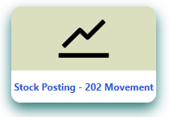
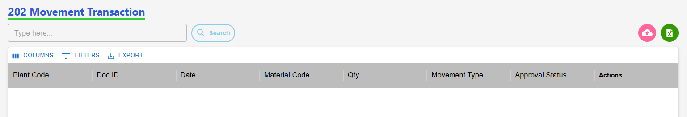
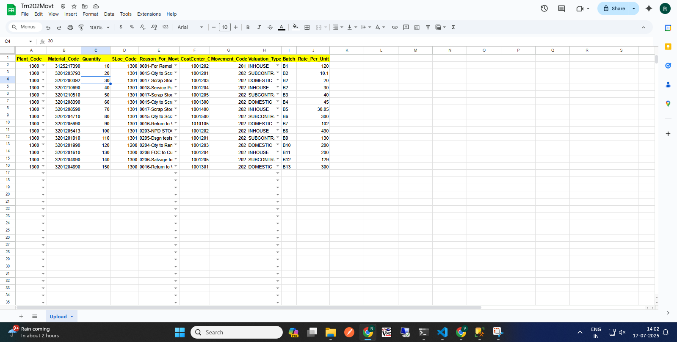
202 Movement Request (Requester)
(2)Click to Start a 201 Request
(2)Clic(2)Click to Start a 201 Request
k to Start a 201 Request
(1)Transaction Page Navigation
(2)Click to Start a 202 Request
202 Requester Page
Click here
(3) Click here to Download template
(5)Excel Template with Sample Data
(4) Click Row to Upload
(6) Approval workflow
Request >>> L1 Approver: Plant Finance Head >>> L2 Approver: Plant MRPC >>> L3 Approver: Plant Head >>> L4 Approver: CORP Finance Head >>> L5 Approver: Corp MRPC >>> Send to SAP.

Slide 15
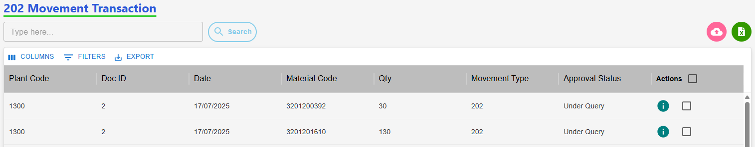
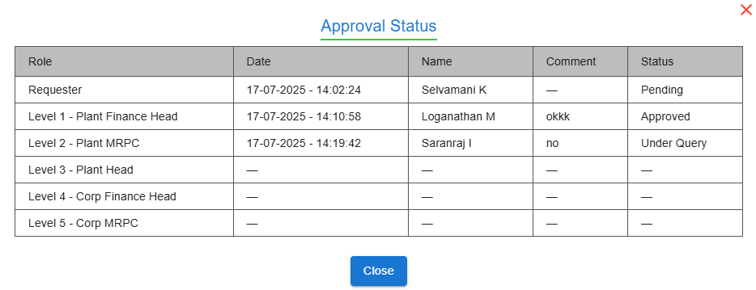
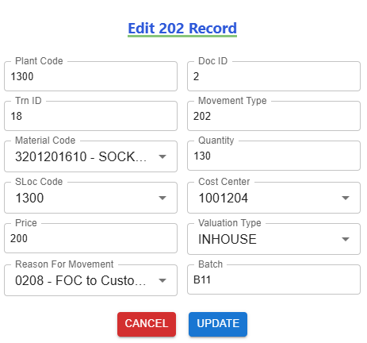
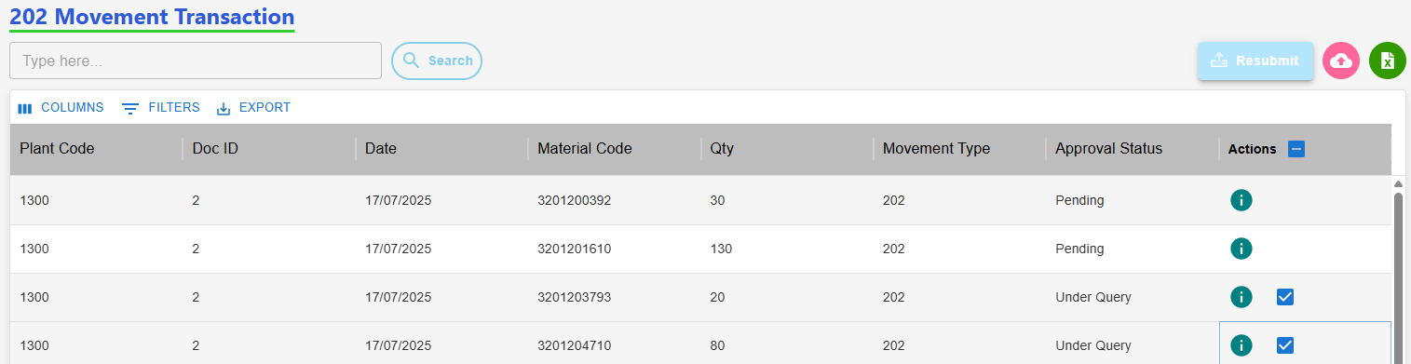
202 Movement: Edit with Status "Under Query" (Requester)
Requester Page After "Under Query" Status
(2) View the Approval Level & Status
(3) Click Row to Edit Row, Then Update
(1) Click here to View status
(4) Select Checkbox, Then Submit Data
Resubmit workflow
Status: Under Query>>> Edit>>> Re-submit>>>Send to Approver.

Slide 16
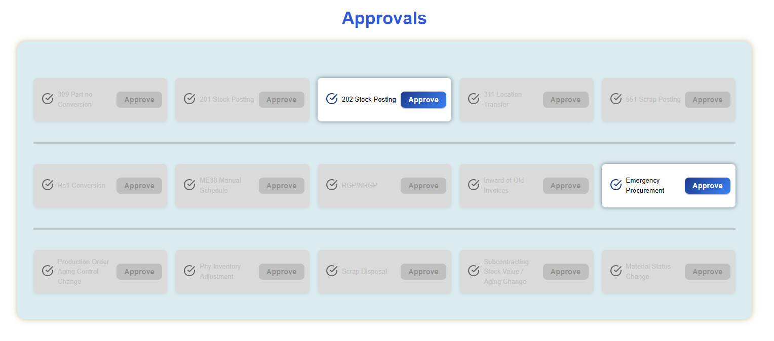
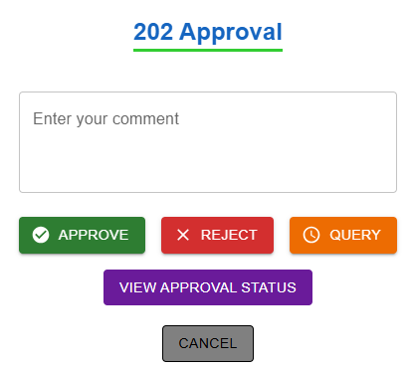
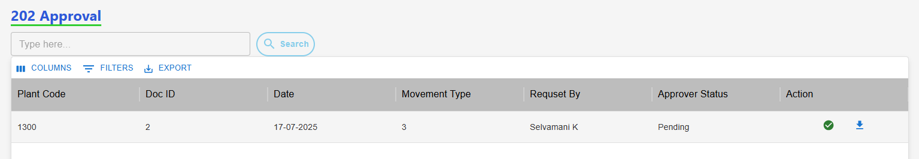
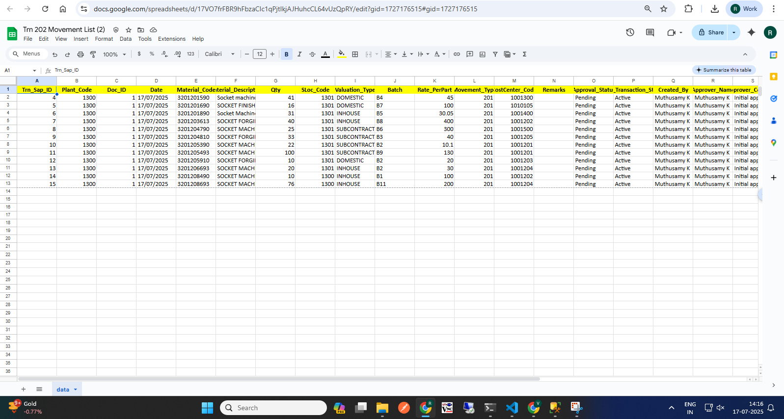
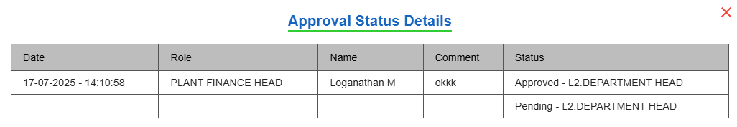
202 Movement Approval (Approver)
Pending request : View the Net Differences.
Then download the XLSX file to review the records.
After reviewing, take the appropriate Action: Approve, Reject, or Raise a Query.
View Status
(1)Approver Home Page
(2)Download Records, Take Action
(7)Action
(6) Click Download Icon to View Records
(5) Click "View Approval Status" to See Last Update
Approver Make Action
Approval workflow: Request >>> L1 Approver: Plant Finance Head >>> L2 Approver: Plant MRPC >>> L3 Approver: Plant Head >>> L4 Approver: CORP Finance Head >>> L5 Approver: Corp MRPC

Slide 17
551 Movement Transaction
Process workflow:
1.Create Request by Users ( PROD / MMD / QAD / MED )
2.Upload Process - Fill in required details
3. Upload Output:
i) New Records, ii) Error Records, iii)Duplicate Records
4. Submit for Approval to Level 1 User.
Level 1 : PLANT FINANCE HEAD
Level 2 : PLANT MRPC
Level 3 : PLANT HEAD
Level 4 : CORP FINANCE HEAD
Level 5 : BUSINESS HEAD
Level 6 : CORP MRPC
5. Requester Page Visible Data: - Only data uploaded by the logged-in user,
Statuses: Pending, Under Query
6. Download Option: - Filtered by From–To Date & Movement Type
7. Editability: - Enabled only if status is Under Query
8. Resubmit Workflow: - Enabled only if status is Under Query Select rows using checkboxes After making corrections, click Resubmit
5

Slide 18
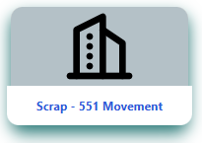
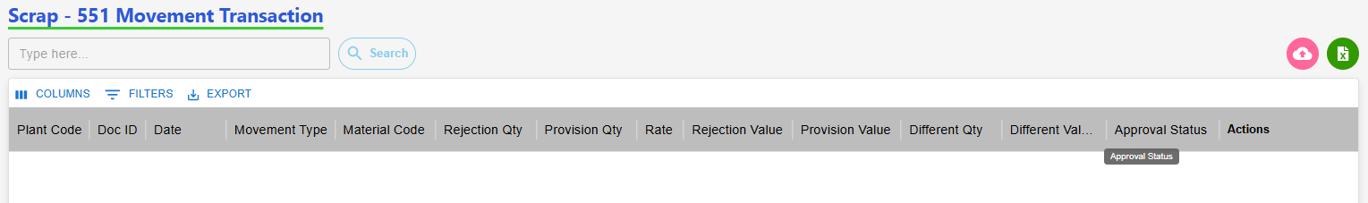
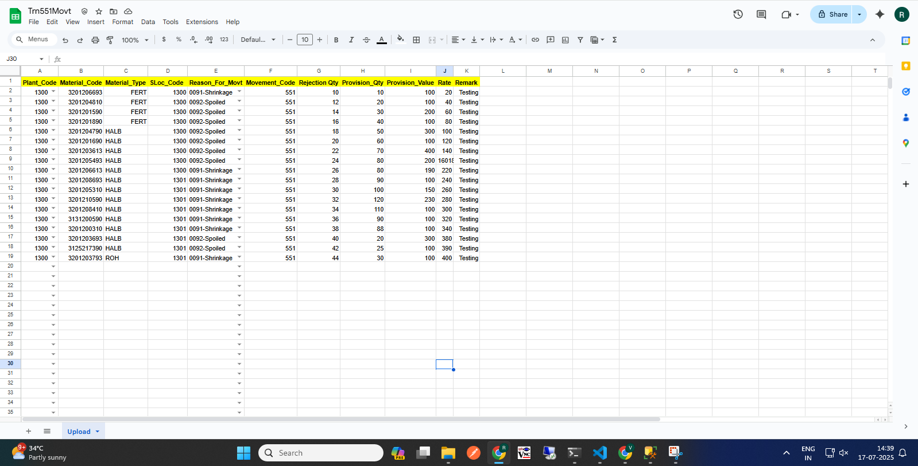
551 Movement Request (Requester)
(2)Click to Start a 201 Request
(2)Clic(2)Click to Start a 201 Request
k to Start a 201 Request
(3) Click here to Download template
(1)Transaction Page Navigation
(2)Click to Start a 551 Request
551 Requester Page
Click here
(5)Excel Template with Sample Data
(4) Click Row to Upload
(6) Approval workflow
Request >>> L1 Approver: Plant Finance Head >>> L2 Approver: Plant MRPC >>> L3 Approver: Plant Head >>> L4 Approver: CORP Finance Head >>> L5 Approver: Business Head>>> L6 Approver: Corp MRPC >>> Send to SAP.

Slide 19
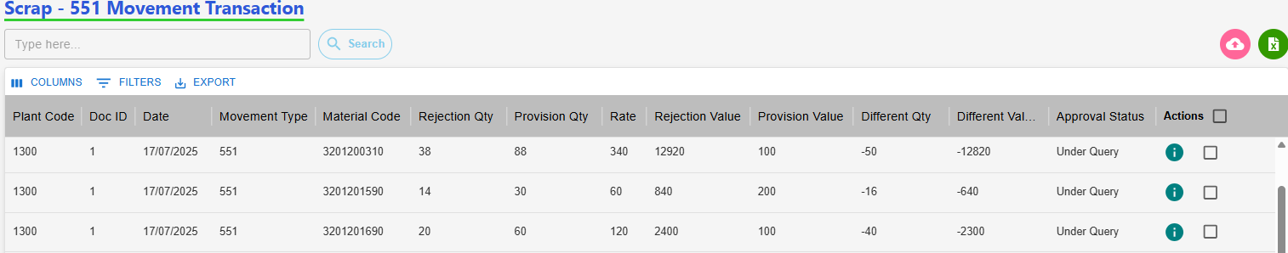
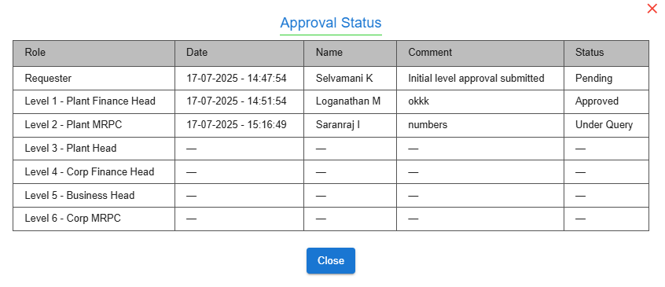
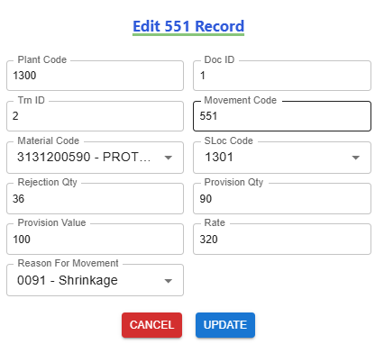
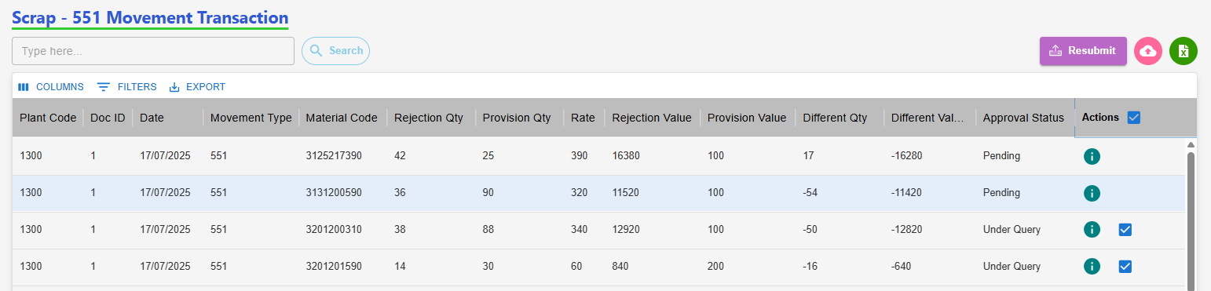
551 Movement: Edit with Status "Under Query" (Requester)
Requester Page After "Under Query" Status
(2) View the Approval Level & Status
(3) Click Row to Edit Row, Then Update
(1) Click here to View status
(4) Select Checkbox, Then Submit Data
Resubmit workflow
Status: Under Query>>> Edit>>> Re-submit>>>Send to Approver.

Slide 20
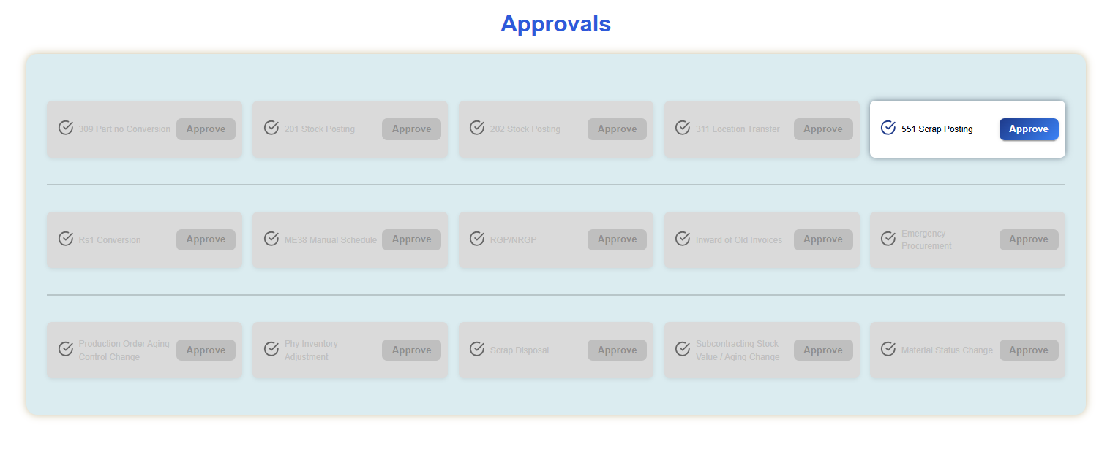
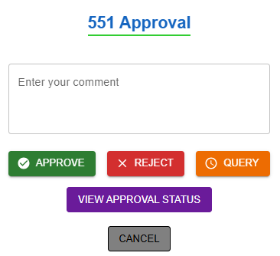


551 Movement Approval (Approver)
Pending request : View the Net Differences.
Then download the XLSX file to review the records.
After reviewing, take the appropriate Action: Approve, Reject, or Raise a Query.
View Status
(1)Approver Home Page
(2) Download Records, Take Action
(7)Action
(6) Click Download Icon to View Records
(5) Click "View Approval Status" to See Last Update
Approver Make Action
Approval workflow: Request >>> L1 Approver: Plant Finance Head >>> L2 Approver: Plant MRPC >>> L3 Approver: Plant Head >>> L4 Approver: CORP Finance Head >>> L5 Approver: Business Head>>> L6 Approver: Corp MRPC

Slide 21
311 Movement Transaction
Process workflow:
1.Create Request by Users ( PROD / MMD / QAD / MED )
2.Upload Process - Fill in required details
3. Upload Output:
i) New Records, ii) Error Records, iii)Duplicate Records
4. Submit for Approval to Level 1 User.
Level 1 : PLANT MRPC
5. Requester Page Visible Data: - Only data uploaded by the logged-in user,
Statuses: Pending, Under Query
6. Download Option: - Filtered by From–To Date & Movement Type
7. Editability: - Enabled only if status is Under Query
8. Resubmit Workflow: - Enabled only if status is Under Query Select rows using checkboxes After making corrections, click Resubmit
5

Slide 22



311 Movement Request (Requester)
(2)Click to Start a 201 Request
(2)Clic(2)Click to Start a 201 Request
k to Start a 201 Request
(1)Transaction Page Navigation
(2)Click to Start a 311 Request
311 Requester Page
Click here
(3) Click here to Download template
(5)Excel Template with Sample Data
(4) Click Row to Upload
(6) Approval workflow
Request >>> L1 Approver: Plant MRPC >>> Send to SAP.

Slide 23




311 Movement: Edit with Status "Under Query" (Requester)
Requester Page After "Under Query" Status
(2) View the Approval Level & Status
(3) Click Row to Edit Row, Then Update
(1) Click here to View status
(4) Select Checkbox, Then Submit Data
Resubmit workflow
Status: Under Query>>> Edit>>> Re-submit>>>Send to Approver.

Slide 24





311 Movement Approval (Approver)
Pending request : View the Net Differences.
Then download the XLSX file to review the records.
After reviewing, take the appropriate Action: Approve, Reject, or Raise a Query.
View Status
(1)Approver Home Page
(2) Download Records, Take Action
(7)Action
(6) Click Download Icon to View Records
(5) Click "View Approval Status" to See Last Update
Approver Make Action
Approval workflow: Request >>> L1 Approver: Plant MRPC

Slide 25
Conversion Rs.1 Movement Transaction
Process workflow:
1.Create Request by Users ( PROD / MMD / QAD / MED )
2.Upload Process - Fill in required details
3. Upload Output:
i) New Records, ii) Error Records, iii)Duplicate Records
4. Submit for Approval to Level 1 User.
Level 1 : PLANT FINANCE HEAD
Level 2 : PLANT HEAD
Level 3 : CORP FINANCE HEAD
Level 4 : BUSINESS HEAD
5. Requester Page Visible Data: - Only data uploaded by the logged-in user,
Statuses: Pending, Under Query
6. Download Option: - Filtered by From–To Date & Movement Type
7. Editability: - Enabled only if status is Under Query
8. Resubmit Workflow: - Enabled only if status is Under Query Select rows using checkboxes After making corrections, click Resubmit
5

Slide 26



Conversion Rs.1 Movement Request (Requester)
(2)Click to Start a 201 Request
(2)Clic(2)Click to Start a 201 Request
k to Start a 201 Request
(1)Transaction Page Navigation
(2)Click to Start a Rs.1 Request
Rs.1 Requester Page
Click here
(3) Click here to Download template
(5)Excel Template with Sample Data
(4) Click Row to Upload
(6) Approval workflow
Request >>> L1 Approver: Plant Finance Head >>> L2 Approver: Plant Head >>> L3 Approver: CORP Finance Head >>> L4 Approver: Business Head >>> Send to SAP.

Slide 27



Conversion Rs.1 Movt: Edit with Status "Under Query" (Requester)
Requester Page After "Under Query" Status
(2) View the Approval Level & Status
(3) Click Row to Edit Row, Then Update
(1) Click here to View status
(4) Select Checkbox, Then Submit Data
Resubmit workflow
Status: Under Query>>> Edit>>> Re-submit>>>Send to Approver.

Slide 28





Conversion Rs.1 Movement Approval (Approver)
Pending request : View the Net Differences.
Then download the XLSX file to review the records.
After reviewing, take the appropriate Action: Approve, Reject, or Raise a Query.
View Status
(1)Approver Home Page
(2) Download Records, Take Action
(7)Action
(6) Click Download Icon to View Records
(5) Click "View Approval Status" to See Last Update
Approver Make Action
Approval workflow: Request >>> L1 Approver: Plant Finance Head >>> L2 Approver: Plant Head >>> L3 Approver: CORP Finance Head >>> L4 Approver: Business Head

Slide 29
Inward of Old Invoices (Purchase) Movement Transaction
Process For Purchase workflow:
1.Create Request by Users ( PROD / MMD / QAD / MED )
2.Add Process - Fill in required details
3. Submit for Approval to Level 1 User
Purchase Approval Workflow
Case (i): If invoice date is less than 1 year: Level 1: Corp MRPC approves → Send to SAP
Case (ii): If invoice date is more than 1 year: Level 1: Corp MRPC reviews and sends to: Level 2: Corp Finance Head or Corp MMD Head. If approved → Send to SAP
4. Requester Page Visible Data: - Only data uploaded by the logged-in user,
Statuses: Waiting, New, Rejected
5. Download Option: - Filtered by From–To Date
6. Editability: - Enabled only if status is Waiting, New, Rejected
Select rows using Edit After making corrections, Resubmit
5

Slide 30



Inward of Old Invoices Purchase Request (Requester)
(2)Click to Start a Purchase Request
Purchase Requester Page
(1)Transaction Page Navigation
(3)Click here to add Purchase
Click here
(4) Add Purchase Here
Approval workflow:
Request >>> Follows Case (i) or Case (ii) based on Invoice Date:
Case (i): Invoice < 1 Year. Level 1: Corp MRPC >>> Send to SAP
Case (ii): Invoice > 1 Year. Level 1: Corp MRPC >>> Level 2: Corp Finance Head or Corp MMD Head>>> Send to SAP

Slide 31





Inward of Old Invoices Purchase Resubmit (Requester)
(2)Click to Start a 201 Request
(2)Clic(2)Click to Start a 201 Request
k to Start a 201 Request
(2)Click to View Status
(3)Click Row to Edit Purchase
(1)Requester Page After Rejected
(5)After editing, add a comment & Resubmit
(4)Click Here to Resubmit
Approval workflow:
Request >>> Follows Case (i) or Case (ii) based on Invoice Date:
Case (i): Invoice < 1 Year. Level 1: Corp MRPC >>> Send to SAP
Case (ii): Invoice > 1 Year. Level 1: Corp MRPC >>> Level 2: Corp Finance Head or Corp MMD Head>>> Send to SAP

Slide 32






Inward of Old Invoices Purchase Approval (Approver)
(2) View Records,
Take Action Case i) or Case ii)
Click the "View" icon to see Purchaser details
(1)Approver Home Page
Case 2
Case 1
Case ii) b. Action
Case ii) a. Action
Case i) Action
Or
Approver workflow :
Case (i): Invoice < 1 Year. Level 1: Corp MRPC >>> Send to SAP
Case (ii): Invoice > 1 Year. Level 1: Corp MRPC >>> Level 2: Corp Finance Head or Corp MMD Head>>> Send to SAP

Slide 33
Inward of Old Invoices Service Movement Transaction
Process For Service workflow:
1.Create Request by Users ( PROD / MMD / QAD / MED )
2.Add Process - Fill in required details
3.Submit for Approval to Level 1 User.
Level 1 : PLANT FINANCE HEAD
Level 2 : CORP MRPC
Level 3 : CORP FINANCE HEAD
5. Requester Page Visible Data: - Only data uploaded by the logged-in user,
Statuses: Waiting, New, Rejected
6. Download Option: - Filtered by From–To Date
7. Editability: - Enabled only if status is Waiting, New, Rejected
Select rows using Edit After making corrections, Resubmit
5

Slide 34


Inward of Old Invoices Service Movement Transaction Request (Requester)
(3)Service Requester Page
(1)Transaction Page Navigation
(2)Click to Start a Service Request
Click here
(4) Service Requester Page
Click here to add Service
(5) Approval workflow
Request >>> L1 Approver: Plant Finance Head >>> L2 Approver: CORP MRPC >>> L3 Approver: CORP Finance Head >>> Send to SAP.

Slide 35



Inward of Old Invoices Service Movement Transaction Resubmit (Requester)
(1)Requester Page After Rejected
(2)Click to View Status
(3)Click Row to Edit Service
(5)After editing, add a comment & Resubmit
(4)Click Here to Resubmit
(6) Approval workflow
Request >>> L1 Approver: Plant Finance Head >>> L2 Approver: CORP MRPC >>> L3 Approver: CORP Finance Head >>> Send to SAP.

Slide 36



Inward of Old Invoices Service Movement Transaction Approval (Approver)
Action: View the Service order details
After View the order , then Take Action
Last Level Approver send ( Sap)- check box
(1)Approver Home Page
(2) View Records, Take Action
Select checkbox to send SAP
(3) Click APProver Icon Take Action
Approver Make Action
Approval workflow: Request >>> L1 Approver: Plant Finance Head >>> L2 Approver: CORP MRPC >>> L3 Approver: CORP Finance Head >>> Send to SAP.

Slide 37
Emergency Procurement Movement Transaction
Process For Purchase workflow:
1.Create Request by Users ( PROD / MMD / QAD / MED )
2.Add Process - Fill in required details
3.Submit for Approval to Level 1 User.
Level 1 : PLANT MRPC
Level 2 : PLANT FINANCE HEAD
Level 3 : PLANT HEAD (after 3 approval finished mail trigger to the gate office)
5. Requester Page Visible Data: - Only data uploaded by the logged-in user,
Statuses: Waiting, New, Rejected
6. Download Option: - Filtered by From–To Date
7. Editability: - Enabled only if status is Waiting, New, Rejected
Select rows using Edit After making corrections, Resubmit
Purchase Order Insert Later (If Not Update PO Mail Trigger TO Approval’s)
5

Slide 38



Emergency Procurement Movement Transaction Request (Requester)
(3) Emergency Requester Page
(1)Transaction Page Navigation
(2)Click to Start a Emergency Request
Click here
Click here to add Service
(4) Service Requester Page
(6) Approval workflow
Request >>> L1 Approver: Plant MRPC >>> L2 Approver: Plant Finance Head >>> L3 Approver: Plant Head >>> Send to SAP.

Slide 39



Emergency Procurement Movement Transaction Resubmit (Requester)
(1)Requester Page After Rejected
(2)Click to View Status
(3)Click Row to Edit Service
(5)After editing, add a comment & Resubmit
(4)Click Here to Resubmit
(6) Approval workflow
Request >>> L1 Approver: Plant MRPC >>> L2 Approver: Plant Finance Head >>> L3 Approver: Plant Head >>> Send to SAP.

Slide 40


Emergency Procurement Movement Transaction Approval (Approver)
Action: View the Emergency details
After View the order , then Take Action
Last Level Approver Send ( Sap)- check box
(2) View Records, Take Action
(1)Approver Home Page
Select checkbox to send SAP
(3) Click APProver Icon Take Action
(4) Approver Make Action
Approval workflow: Request >>> L1 Approver: Plant MRPC >>> L2 Approver: Plant Finance Head >>> L3 Approver: Plant Head >>> Send to SAP.

Slide 43
Thank you

